Slide 1
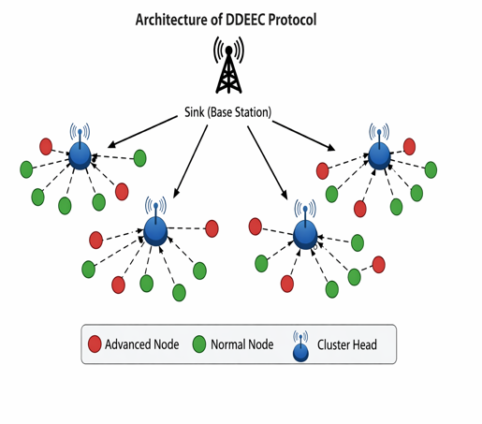
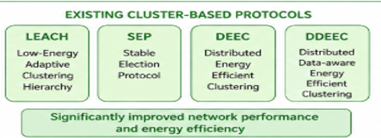
DDEEC
IMPROVING DATA TRANSMISSION EFFICIENCY IN DEVELOPED DISTRIBUTED ENERGY EFFICIENT CLUSTERING FOR HETEROGENEOUS WIRELESS SENSOR NETWORKS

Slide 2
Why is this project important?
Wireless Sensor Networks use battery-powered sensor nodes. If the battery is drained quickly, the network stops working. So, saving energy is very important.
Objective of the Project
The main objective of our project is to reduce energy consumption, improve data transmission, reduce congestion, and increase the lifetime of the network.
What problem are we solving?
In the existing DDEEC protocol, many sensor nodes send data at the same time. Our project solves this problem by controlling data transmission using the Token Bucket Algorithm.

Slide 3
Main Solution
Our solution is to combine the DDEEC protocol with the Token Bucket Algorithm. This controls the data flow, balances energy usage, and increases the network lifetime.
Technologies Used
MATLAB – for simulation
Wireless Sensor Networks (WSN)
DDEEC Protocol
Token Bucket Algorithm
My Role In The Project
SEP(stable election protocol): SEP is a cluster based routing protocol used in heterogenous wireless sensor networks used in advanced nodes(higher probability) and normal nodes(lower probability).

Slide 4
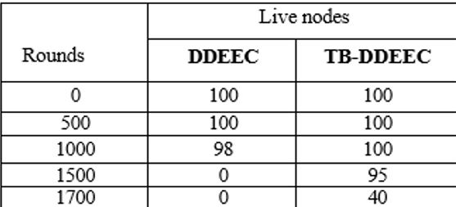
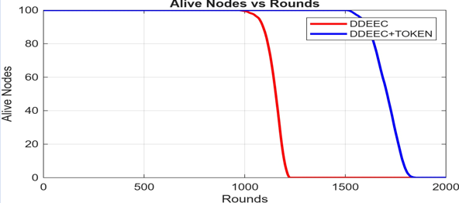
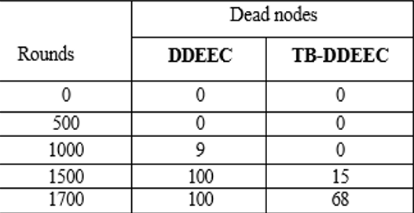
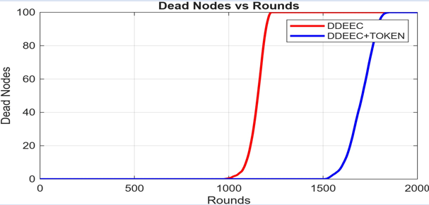
output

Slide 5
THANK YOU

